Slide 1
Artificial Intelligence: Search Strategies
Santosh GSK
SENIOR DATA SCIENTIST
INDUSTRY EXPERT
OFFCAMPUS PROGRAM

Slide 2
Agent Architecture Recap
Simple Reflex Agent
Model based Agent
Goal based Agent
Utility based Agent
Learning based Agent

Slide 3
Agent Architecture Recap
Simple Reflex Agent
Model based Agent
Goal based Agent
Utility based Agent
Learning based Agent

Slide 4
Agent Architecture Recap
Simple Reflex Agent
Model based Agent
Goal based Agent
Problem Solving Agents
Utility based Agent
Learning based Agent

Slide 5
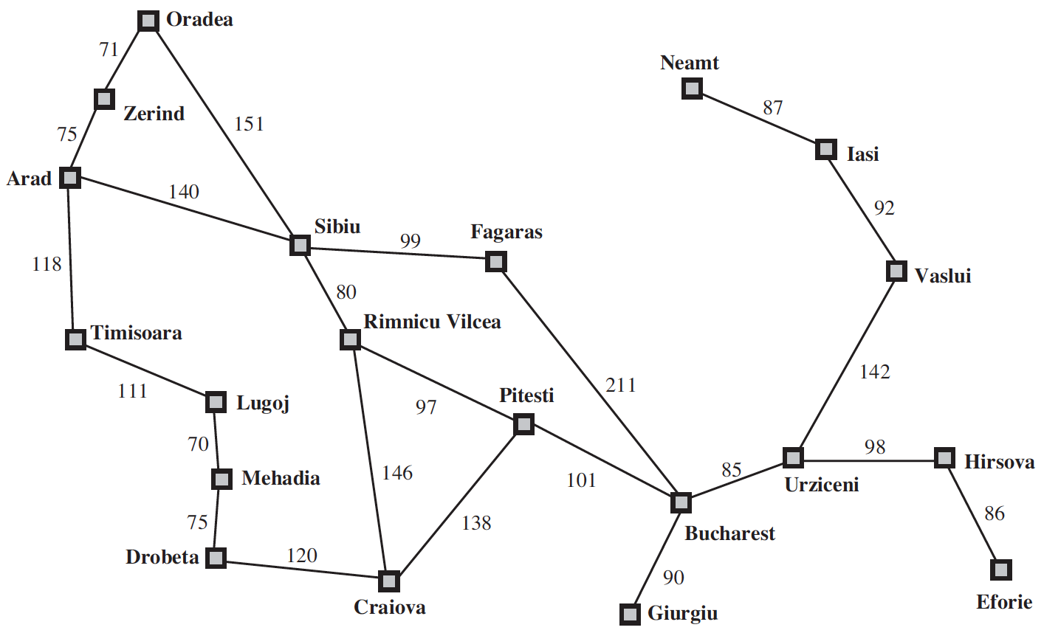
Problem Solving Agents
Agent is here

Slide 6
Problem Solving Agents
Agent is holidaying in Arad.
Many factors in its performance measure
Tour the famous places
Try local cuisine
Souvenir Shopping

Slide 7
Problem Solving Agents
Agent is here

Slide 8
Problem Solving Agents
Goal Formulation
Optimizes the agent’s objectives
Thereby, limits the actions that can be taken

Slide 9
Problem Solving Agents
In order to reach the Goal – Bucharest
Several States and Actions are possible
Agent can drive to airport or can hire a taxi or take a bus
Agent can take a detour to another city and board a flight to Bucharest
Problem Formulation: Process of deciding what actions and states to consider, given a goal

Slide 10
Problem Solving Agents
Unknowns about the Environment
Doesn’t know what state the agent is in
Estimation of number of possible actions
Doesn’t know the value of actions
Doesn’t know the resulting state of actions
Assumptions about the Environment
Observable: Agent always knows the current state
Discrete: At any given state, only finitely many actions to choose from
Known: Knows which states are reached by each action
Deterministic: Each action would always have the same resulting state

Slide 11
Problem Solving Agents
Under these assumptions, the solution would be
A Fixed Sequence of Actions
Search: The process of looking for a fixed sequence of actions that reaches a goal
Search Algorithm: Takes problem as input and outputs sequence of actions

Slide 12
Problem Solving Agents
Formulate – Define the problem and its components
Search – Solve the problem using search algorithms
Execute – Execute the solution of fixed sequence of actions

Slide 13
Problem Solving Agents – Formulate
A problem can be formulated using five components
Initial State – The agent’s starting state. E.g., In(Arad)
Possible Actions – Set of applicable actions in a given state. E.g., from the state s = In(Arad), applicable actions
ACTIONS(s) ➔ {Go(Sibiu), Go(Timisoara), Go(Zerind)}
Transition Model – The resulting state of an action in a given state, modeled as RESULT(s, a)
RESULT( In(Arad), Go(Sibiu) ) = In(Sibiu)
Goal Test – Determines whether a given state is a goal state.
IsGoal( In(Bucharest) ) = Yes
Path Cost – A function that assigns a numeric cost to each path. A path is a series of actions. Each action is given a cost depending on the problem.
cost( In(Arad), go(Sibiu)) = 140 kms

Slide 14
Problem Solving Agents – Formulate
In the above definition
Many possible states – In(Arad), the agent has many possibilities in real world, e.g., can be in the middle of Arad, near an airport, shopping center, hotel, etc.
Many possible actions – Agent can take several actions while driving from Arad to Sibiu. It can halt at a place, take a detour, turn the radio on.
However, they are irrelevant for finding the solution of path to Bucharest
Hence, can be abstracted
Abstraction – Process of removing detail from a representation

Slide 15
Formulate - Examples
Toy Problems – Intended to illustrate or exercise various problem solving methods. Useful in research for comparing the performance of algorithms
Real-World Problems – Problems for which solutions can be impacting people’s daily lives.

Slide 16

Formulate – Toy Problem Example
Vacuum World

Slide 17
Formulate – Toy Problem Example
Possible States – There are two locations and two possibilities of dirt. Hence, there would be a total of 8 possible states, i.e., 2x2²
Initial State – Any state with position of agent and dirt mentioned
Actions – Three possible actions, Left, Right, Suck
Transition Model – Left would move the agent to left location, except when the agent is in leftmost location, there would be no effect. Similarly for Right action. Suck would remove the dirt, if any.
Goal Test – Checks whether all locations are clean
Path cost – Each step costs 1, so the path cost is total number of steps

Slide 18
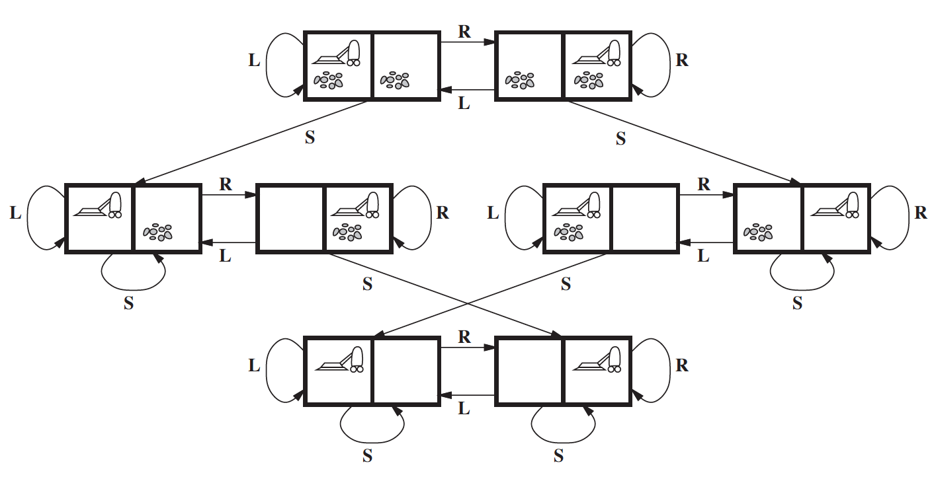
Formulate – Toy Problem Example

Slide 19
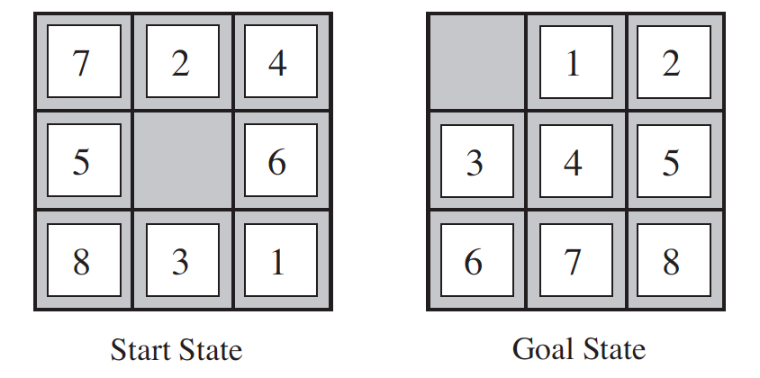
Formulate – Toy Problem Example
8-puzzle

Slide 20
Formulate – Toy Problem Example
Possible states = 9! / 2
Initial State – Any permutation of 1-8 numbers with a blank
Actions – Movement of blank space either by Left, Right, Up or Down
Transition Model – The resulting state after moving the blank space will replace the digit
Goal Test – Check whether the state matches the goal configuration
Path cost – Each step costs 1, so the path cost is total number of steps

Slide 21
Formulate – Real World Example
Route finding problem, e.g., Google Maps

Slide 22
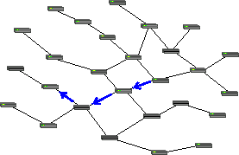
Formulate – Real World Example
Routing Video Streams in Computer Networks

Slide 23
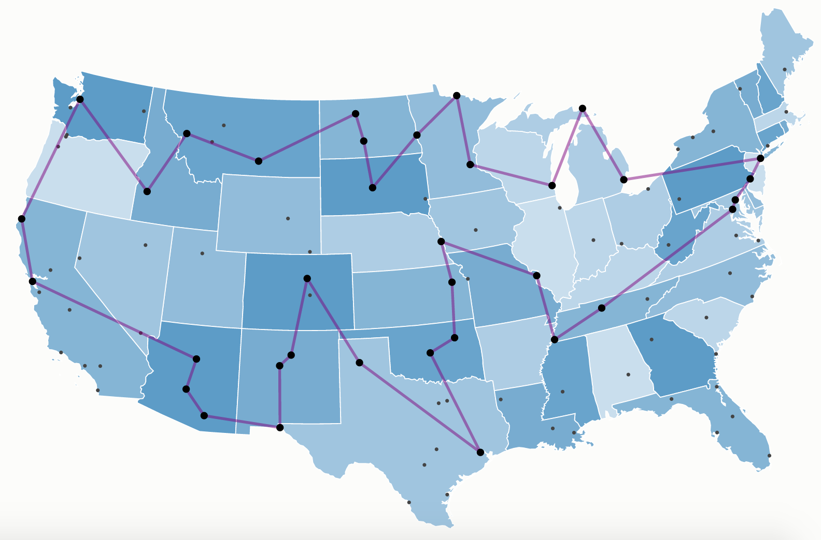
Formulate – Real World Examples
Traveling Salesman problem

Slide 24
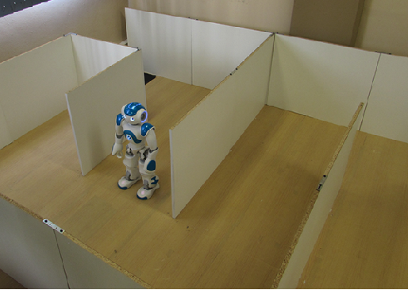
Formulate – Real World Example
Robot Navigation

Slide 25
Formulate – Real World Example
Airline Travel problem – the task of a travel agent to book cheapest and fastest flight route from City A to City B.
E.g., Need to Travel from Delhi to Los Angeles within Rs. 70,000
Possible States – Each state is a location and current time.
Initial State – Specified by User’s query
Actions – Flight from current location at a particular time with enough time for within-airport transfer if needed
Transition Model – The destination location and arrival time
Goal test – Are we at final destination at the specified time?
Path Cost – Flight cost + Duration + Waiting time + Immigration, etc.

Slide 26
Searching for Solutions
Solution for above Problems: A sequence of possible actions starting at the initial state and reaching the destination specified
Search Algorithms:
Given problem formulation as input, these algorithms would output the sequence of actions
Search Trees - Where states are nodes and actions are edges. The initial state will be the root node and possible actions are branches
In(Arad)
Parent Node
Go(Sibiu)
Go(Timisoara)
Go(Zerind)
In(Sibiu)
In(Timisoara)
In(Zerind)
Child Nodes

Slide 27
Searching for Solutions
In(Arad)
Generation
Go(Sibiu)
Go(Timisoara)
Go(Zerind)
Expansion
In(Sibiu)
In(Timisoara)
In(Zerind)
Search Problem: Which branch to generate next?

Slide 28
Tree Search Algorithm
In(Arad)
Go(Sibiu)
Go(Timisoara)
Go(Zerind)
In(Sibiu)
In(Timisoara)
In(Zerind)
Go(Arad)
Go(Fagaras)
Go(Oradea)
Go(Rimnicu Vilcea)
In(Arad)
In(Fagaras)
In(Oradea)
In(Rimnicu Vilcea)
Tree – Search Algorithm

Slide 29
Tree Search Algorithm
In(Arad)
Go(Sibiu)
Go(Timisoara)
Go(Zerind)
In(Sibiu)
In(Timisoara)
In(Zerind)
Go(Arad)
Go(Fagaras)
Go(Oradea)
Go(Rimnicu Vilcea)
In(Arad)
In(Fagaras)
In(Oradea)
In(Rimnicu Vilcea)
Leaf Nodes
(no children yet)
Frontier: Set of all leaf nodes available for expansion at any given point
Search Strategy: Choosing which state to expand next

Slide 30
Tree Search Algorithm
In(Arad)
Repeated State
generated by
Loopy Path
Go(Sibiu)
Go(Timisoara)
Go(Zerind)
In(Sibiu)
In(Timisoara)
In(Zerind)
Go(Arad)
Go(Fagaras)
Go(Oradea)
Go(Rimnicu Vilcea)
In(Arad)
In(Fagaras)
In(Oradea)
In(Rimnicu Vilcea)
Redundant Path: More than one way to reach a state from another.
E.g., Arad – Sibiu (140 kms) and Arad-Zerind-Oradea-Sibiu (297 kms)
Loopy Path is a special case

Slide 31
Graph Search Algorithm
To solve the Redundancy Path problem,
Explored Set: keeps track of states that are already visited
Augments the Tree-Search algorithm to solve redundancy
We call it Graph-Search Algorithm
Therefore, the search tree contains at most one copy of each state
Growing a tree directly on the state-space graph

Slide 32
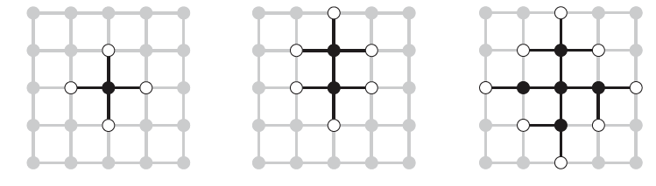
Graph Search Algorithm
Rectangular Grid Problem

Slide 33
Graph Search Algorithm

Slide 34
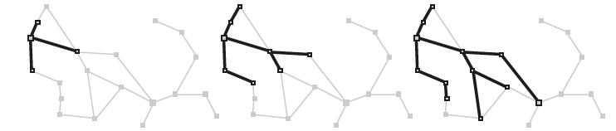
Graph Search Algorithm
Zerind
Arad
Sibiu
Timisoara

Slide 35
Infrastructure for Search Algorithms
For each node n of the tree,
n.STATE: the state in the state space to which node corresponds
n.PARENT: the node in the search tree that generated this node
n.ACTION: the action that was applied to parent to generate the node
n.PATH-COST: the cost, denoted by g(n), of the path from initial state to node
Parent
State = Sibiu
Action = Go(Sibiu)
Path Cost = 300kms
Node

Slide 36
Infrastructure for Search Algorithms
Nodes vs States
Node – a bookkeeping data structure used to represent the search tree
State – configuration of the world
Two different nodes might have same state – if that state is generated from two different paths
Frontier – needs to be stored in a queue with a strategy to help pick the next node for expansion
Strategies can be
FIFO (First In First Out) – Pops the oldest element of the queue
LIFO (Last In First Out) – Pops the newest element of the queue
Priority Queue – pops the element with highest priority

Slide 37
Measuring Search Algorithm Performance
Completeness – Is the algorithm guaranteed to find a solution when there is one?
Optimality – Does the algorithm find the optimal solution?
Time Complexity – How long does it take to find the solution?
Space Complexity – How much memory is needed to perform the search?

Slide 38
Measuring Search Algorithm Performance
Time and space complexity
Search in AI is represented by initial state, actions and transitions which usually result in infinite Nodes and Edges in a graph.
Hence, the complexity is rather measured by
Branching Factor b: Maximum number of successors of any node
Depth d of the shallowest goal, i.e., number of steps from initial node
Maximum length (m) of any path in state space

Slide 39
Measuring Search Algorithm Performance
Effectiveness of an algorithm can be measured by:
Search Cost: Time spent by the algorithm in finding a solution (can also include memory usage)
Solution Cost: Path cost of the solution
Total Cost: Search Cost + Solution Cost (if not in same units, convert them)

Slide 40
Search Algorithms
Uninformed Search Algorithms
No additional information about states beyond what is provided in problem formulation
Generate successors and distinguish a goal state from a non-goal state
Informed Search Algorithms
Strategies that know if one non-goal state is more promising than another non-goal state
Also called Heuristic Search strategies

Slide 41
Uninformed Search Algorithms
Breadth First Search
Uniform Cost Search
Depth First Search
Depth Limited Search
Iterative deepening Depth First Search

Slide 42
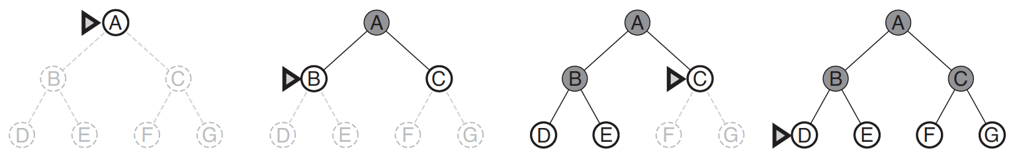
Breadth First Search (BFS)
Generate all nodes at a given depth
before proceeding to deeper nodes

Slide 43
Breadth First Search
All nodes at a given depth are expanded first before any nodes at next level
FIFO queue for Frontier
Shallowest (min depth) unexpanded node is chosen for expansion
Instance of general graph-search algorithm
Discards any redundant path by checking with Explored Set and Frontier Set (must have a path shallower which was seen before)
Hence, it always has the shallowest path to every state

Slide 44
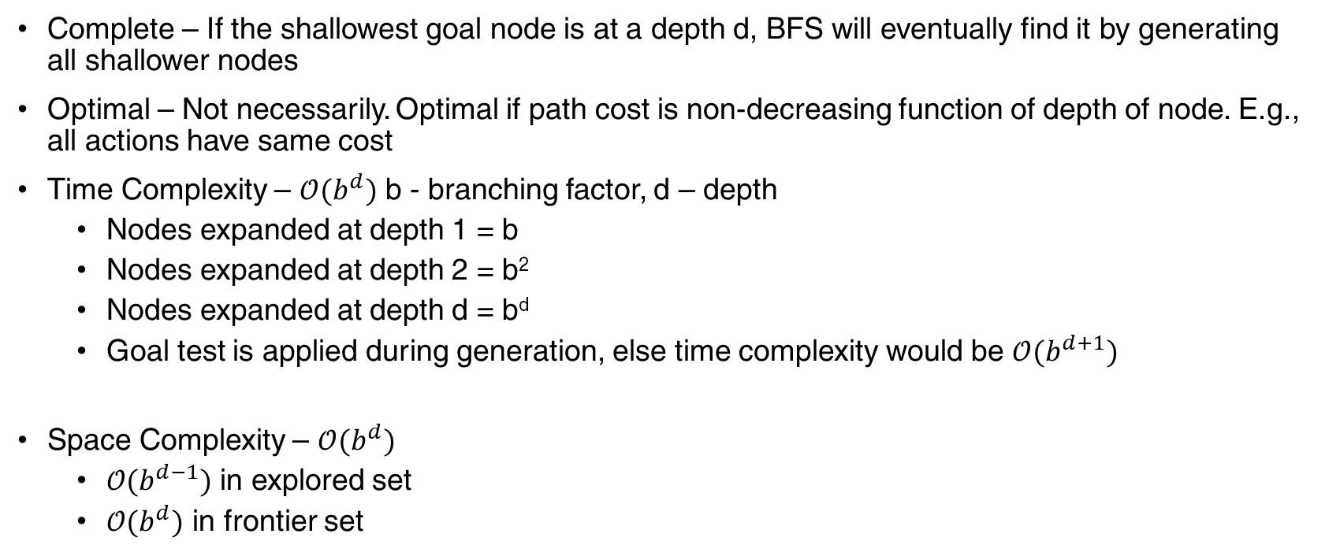
Breadth First Search – Evaluation
Complete – If the shallowest goal node is at a depth d, BFS will eventually find it by generating all shallower nodes
Optimal – Not necessarily. Optimal if path cost is non-decreasing function of depth of node. E.g., all actions have same cost
Time Complexity – $𝒪(b^{d})$ b - branching factor, d – depth
Nodes expanded at depth 1 = b
Nodes expanded at depth 2 = b²
Nodes expanded at depth d = b^{d}
Goal test is applied during generation, else time complexity would be $𝒪(b^{d+1})$
Space Complexity – $𝒪(b^{d})$
$𝒪(b^{d−1})$ in explored set
$𝒪(b^{d})$ in frontier set

Slide 45
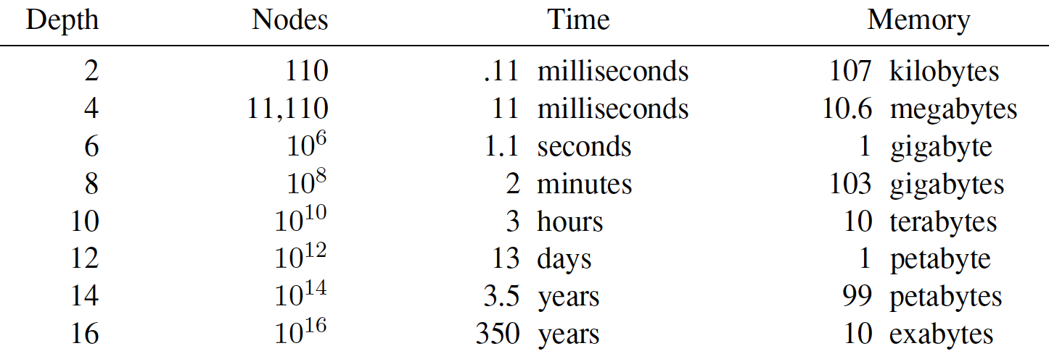
Breadth First Search – Evaluation
Why is Space Complexity a big problem? Imagine a problem with
branching factor b = 10
generates 1 million nodes/sec
Each node requires 1KB

Slide 46
Uniform Cost Search
Instead of expanding the shallowest node, Uniform-Cost search expands the node n with the lowest path cost g(n)
Sorting the Frontier as a priority queue ordered by g(n)
Goal test is applied during expansion
The goal node if generated may not be on the optimal path
Find a better path to a node on the Frontier

Slide 47
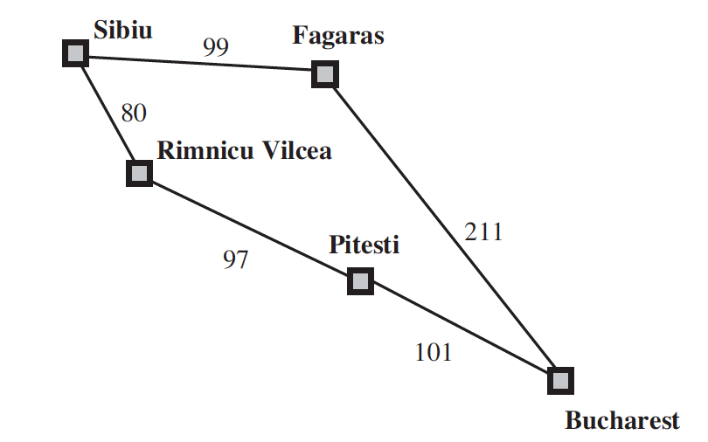
Uniform Cost Search
Current State: Sibiu
Frontier: []
Step: Expand Sibiu
Result: Generates (“Rimnicu Vilcea” 80)
(“Fagaras”, 99)
Add to Frontier
Initial State: Sibiu
Goal State: Bucharest

Slide 48
Uniform Cost Search
Current State: Sibiu
Frontier: [(“Rimnicu Vilcea” 80)
(“Fagaras”, 99)]
Step: Expand “Rimnicu Vilcea” (least cost)
Result: Generates (“Pitesti”, 177)
Add to Frontier
Initial State: Sibiu
Goal State: Bucharest

Slide 49
Uniform Cost Search
Current State: Rimnicu Vilcea (not a Goal state)
Frontier: [ (“Fagaras”, 99)
(“Pitesti”, 177)]
Step: Expand “Fagaras” (least cost)
Result: Generates (“Bucharest”, 310)
Add to Frontier
(It’s a Goal State but we won’t
test during generation)
Initial State: Sibiu
Goal State: Bucharest

Slide 50
Uniform Cost Search
Current State: Fagaras (not a goal state)
Frontier: [ (“Pitesti”, 177)
(“Bucharest”, 310)]
Step: Expand “Pitesti” (least cost)
Result: Generates (“Bucharest”, 278)
Replace in Frontier
(It’s a Goal State but we won’t
test during generation)
Initial State: Sibiu
Goal State: Bucharest

Slide 51
Uniform Cost Search
Current State: Pitesti (not a goal state)
Frontier: [ (“Bucharest”, 278)]
Step: Expand “Bucharest”
Result: No further generation
as Goal Test satisfied
Return Solution
Initial State: Sibiu
Goal State: Bucharest

Slide 52
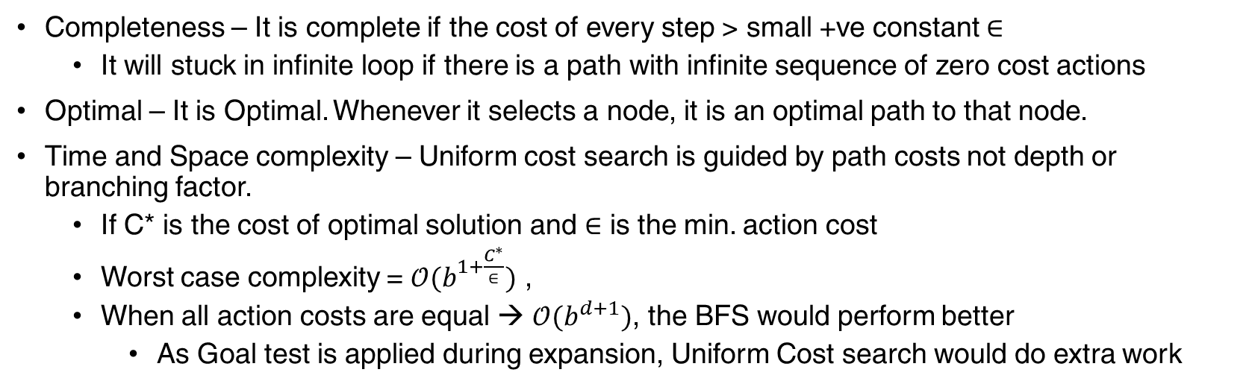
Uniform Cost Search – Evaluation
Completeness – It is complete if the cost of every step > small +ve constant $∈$
It will stuck in infinite loop if there is a path with infinite sequence of zero cost actions
Optimal – It is Optimal. Whenever it selects a node, it is an optimal path to that node.
Time and Space complexity – Uniform cost search is guided by path costs not depth or branching factor.
If C* is the cost of optimal solution and $∈$ is the min. action cost
Worst case complexity = $𝒪(b^{1+\frac{C^{∗}}{∈}})$ ,
When all action costs are equal → $𝒪(b^{d+1})$, the BFS would perform better
As Goal test is applied during expansion, Uniform Cost search would do extra work

Slide 53
Depth First Search (DFS)
Uses LIFO as the Frontier Strategy
Expands deepest node in current Frontier
Instance of Graph Search Algorithm

Slide 54
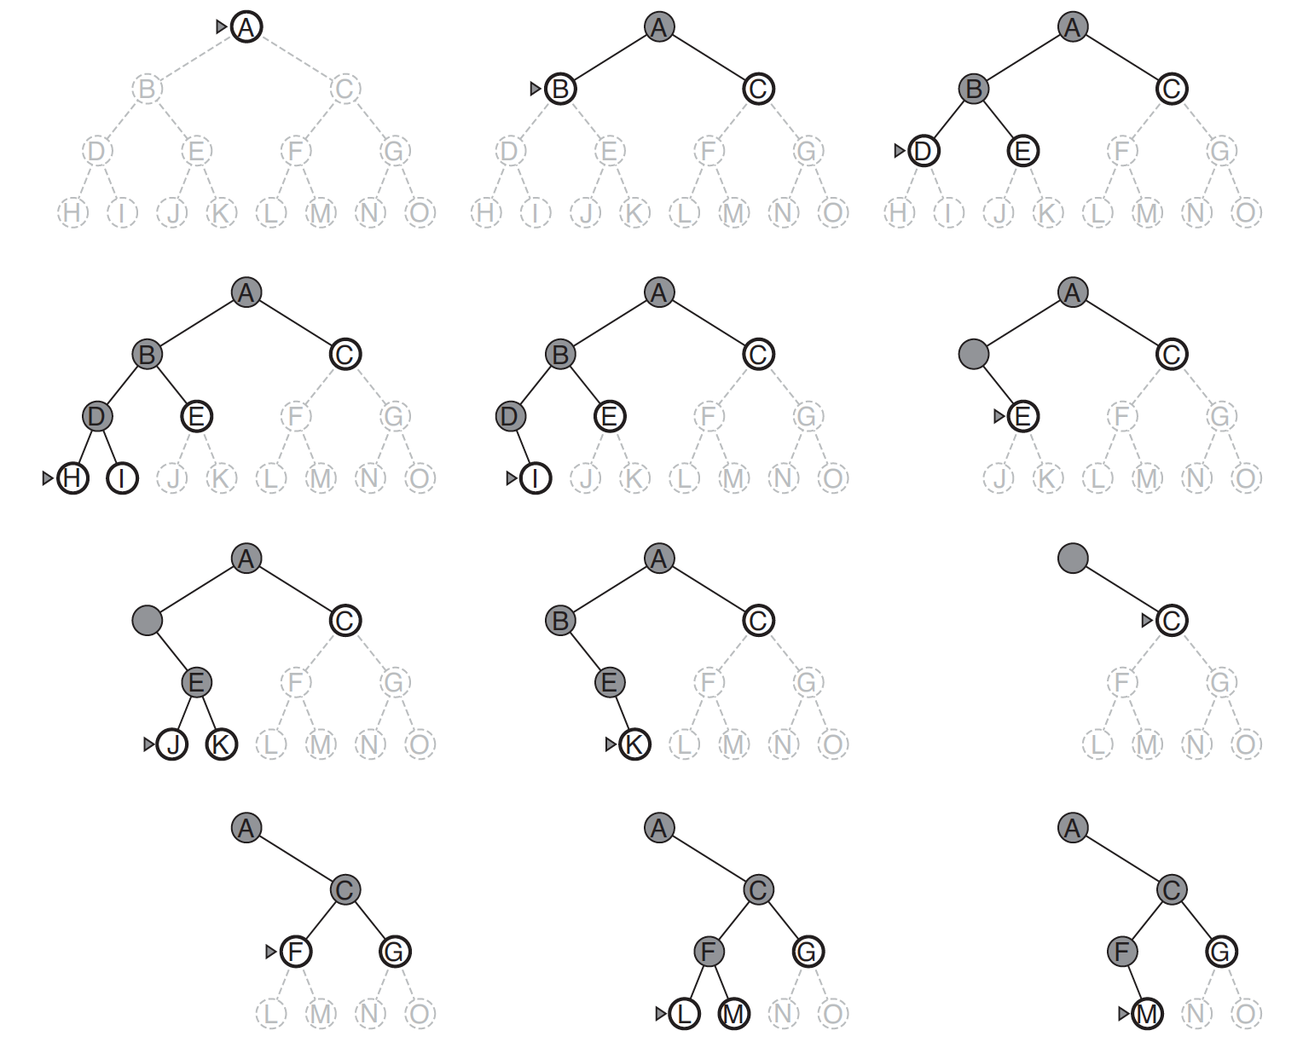
DFS

Slide 55
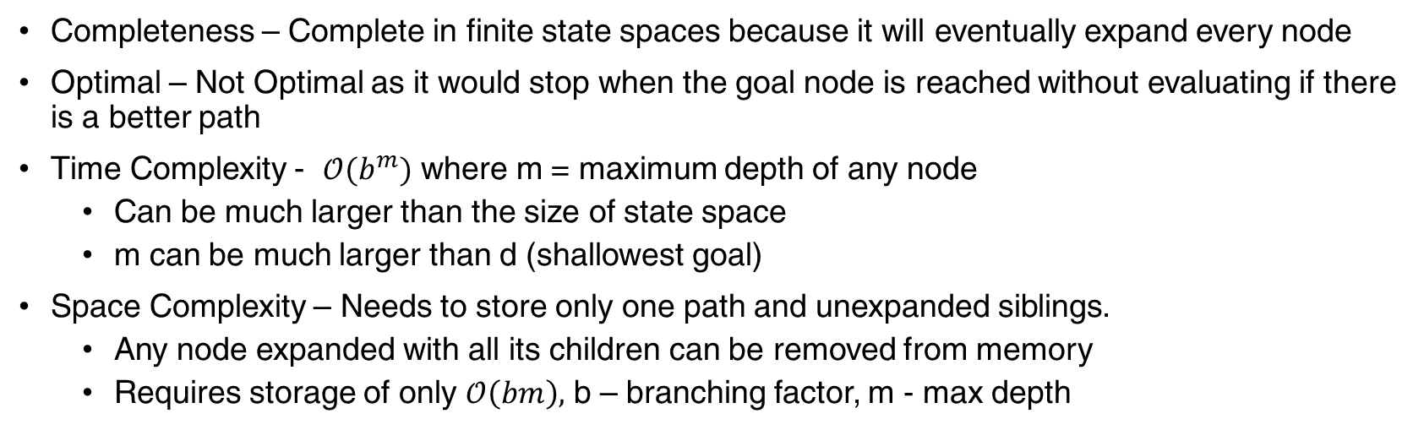
DFS - Evaluation
Completeness – Complete in finite state spaces because it will eventually expand every node
Optimal – Not Optimal as it would stop when the goal node is reached without evaluating if there is a better path
Time Complexity - $𝒪(b^{m})$ where m = maximum depth of any node
Can be much larger than the size of state space
m can be much larger than d (shallowest goal)
Space Complexity – Needs to store only one path and unexpanded siblings.
Any node expanded with all its children can be removed from memory
Requires storage of only $𝒪\left(bm\right),$ b – branching factor, m - max depth

Slide 56
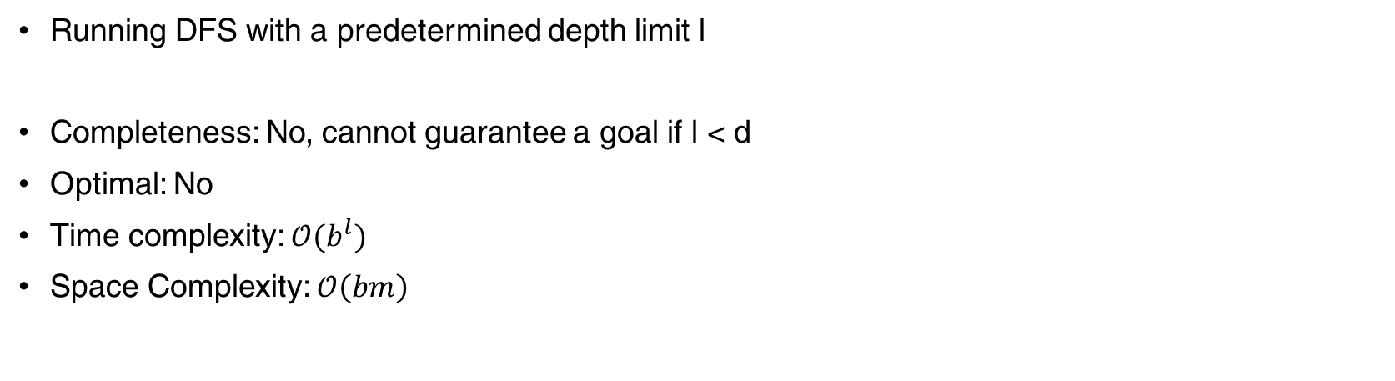
Depth Limited Search (DLS)
Running DFS with a predetermined depth limit l
Completeness: No, cannot guarantee a goal if l < d
Optimal: No
Time complexity: $𝒪(b^{l})$
Space Complexity: $𝒪\left(bm\right)$

Slide 57
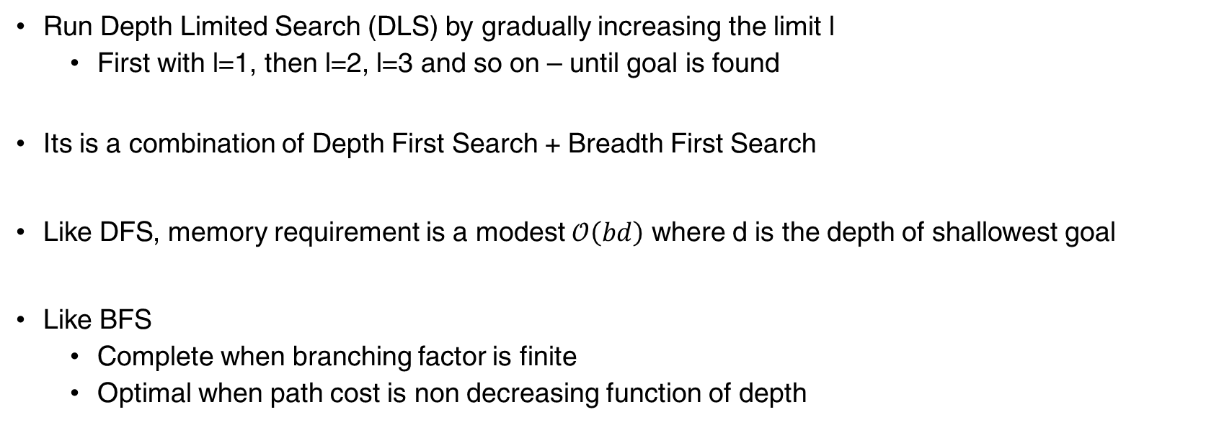
Iterative Deepening Depth First Search (IDS)
Run Depth Limited Search (DLS) by gradually increasing the limit l
First with l=1, then l=2, l=3 and so on – until goal is found
Its is a combination of Depth First Search + Breadth First Search
Like DFS, memory requirement is a modest $𝒪\left(bd\right)$ where d is the depth of shallowest goal
Like BFS
Complete when branching factor is finite
Optimal when path cost is non decreasing function of depth

Slide 58
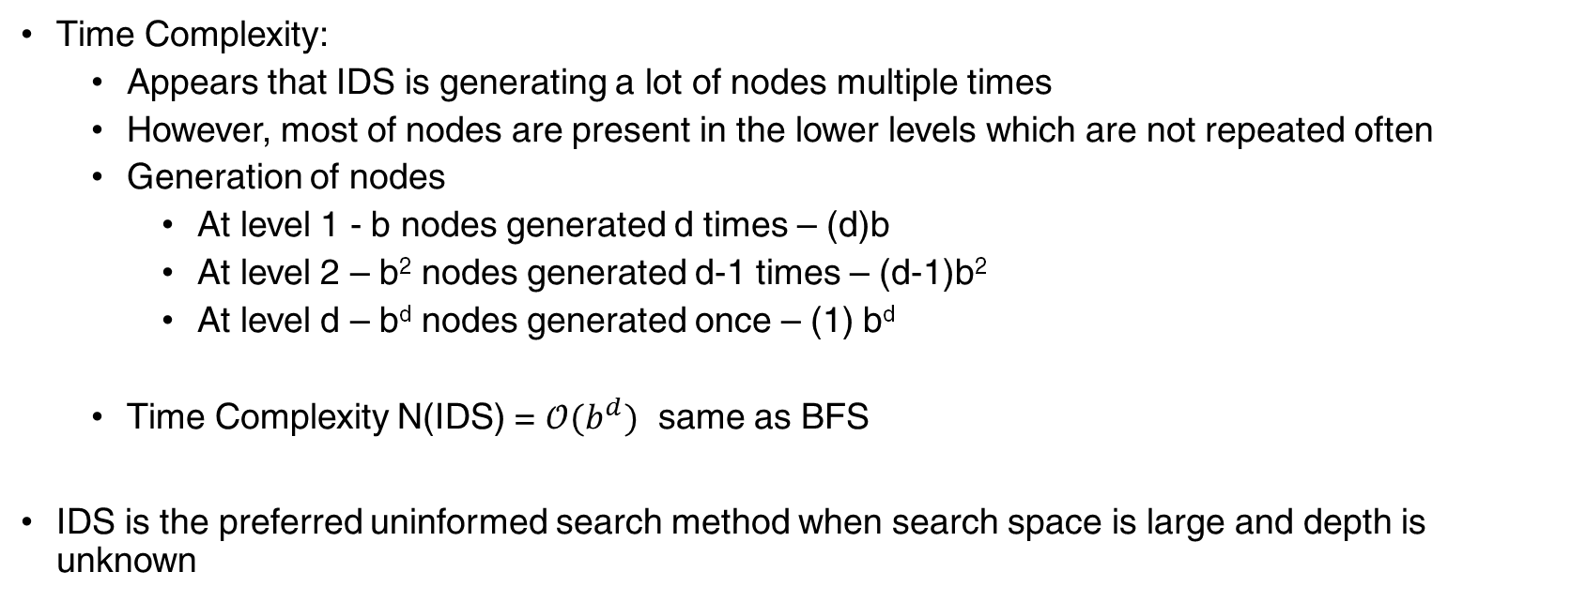
Iterative Deepening Depth First Search (IDS)
Time Complexity:
Appears that IDS is generating a lot of nodes multiple times
However, most of nodes are present in the lower levels which are not repeated often
Generation of nodes
At level 1 - b nodes generated d times – (d)b
At level 2 – b² nodes generated d-1 times – (d-1)b²
At level d – b^{d} nodes generated once – (1) b^{d}
Time Complexity N(IDS) = $𝒪(b^{d})$ same as BFS
IDS is the preferred uninformed search method when search space is large and depth is unknown

Slide 59
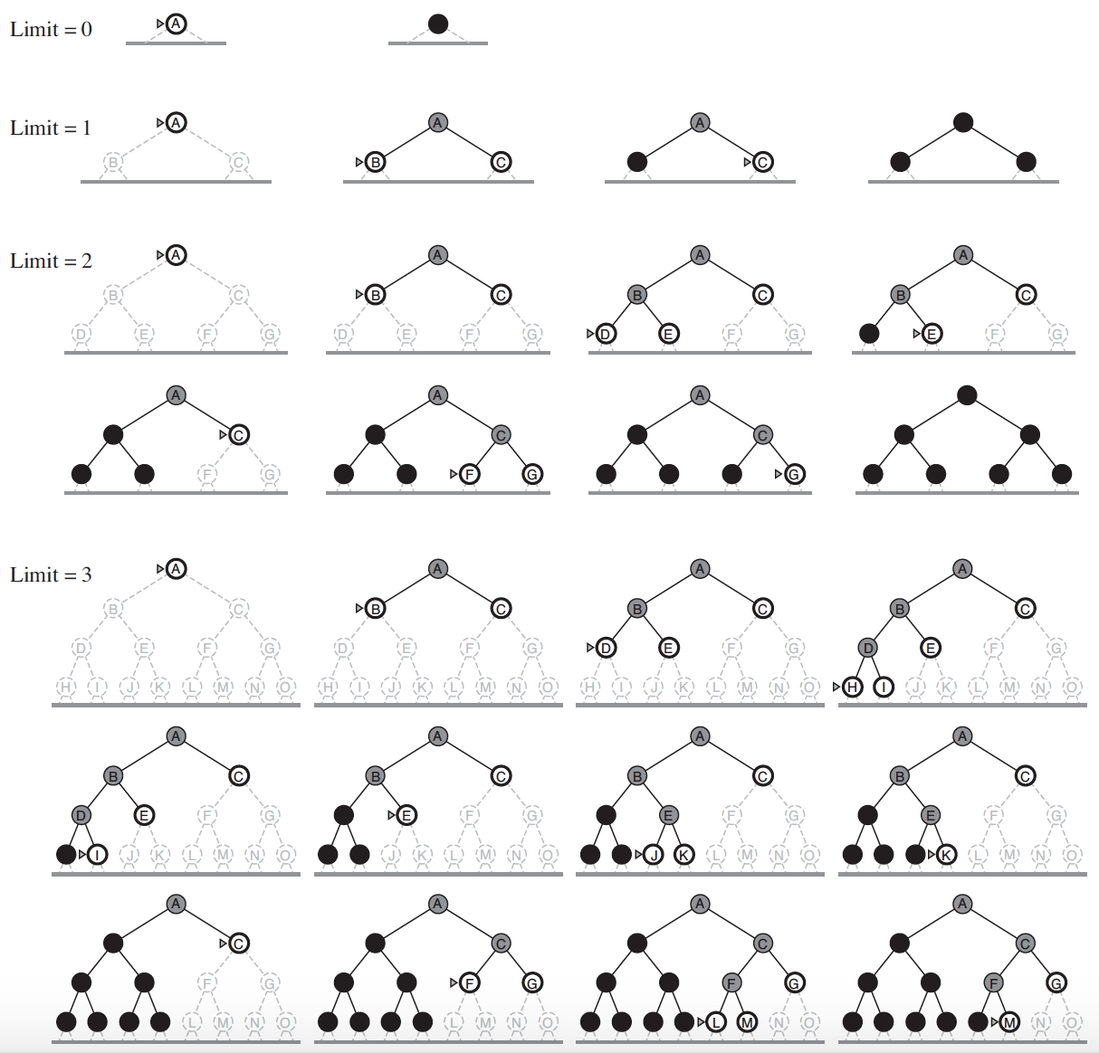
IDS

Slide 60
Informed (Heuristic) Search Strategies
General Approach we follow is Best First Search
- Node is selected for expansion based on evaluation function, f(n)
- Evaluation function is constructed as a cost function
- Node with lowest evaluation is expanded first
- Best First Search is similar to Uniform Cost Search, except we use f(n) instead of g(n)

Slide 61
Informed (Heuristic) Search Strategies
Evaluation function f(n)
It includes a component called heuristic function, h(n)
h(n) = estimated cost of cheapest path from a given node n to goal state
even though h(n) takes node as input, it only considers the state
E.g., if h(n) is the straight line distance between state at node n and goal state
E.g., h(Arad) = Straight line distance between Arad and Bucharest (goal) = 366 kms
Heuristic function h(n) is not part of the problem, it is additional knowledge about problem
h(n) has a constraint, h(n) = 0 if n is goal node

Slide 62
Informed (Heuristic) Search Strategies
h(Arad) = 366
h(Timisoara) = 329

Slide 63
Informed (Heuristic) Search Strategies
Algorithms that use Heuristic functions to guide search
Greedy Best First Search
A* Search

Slide 64
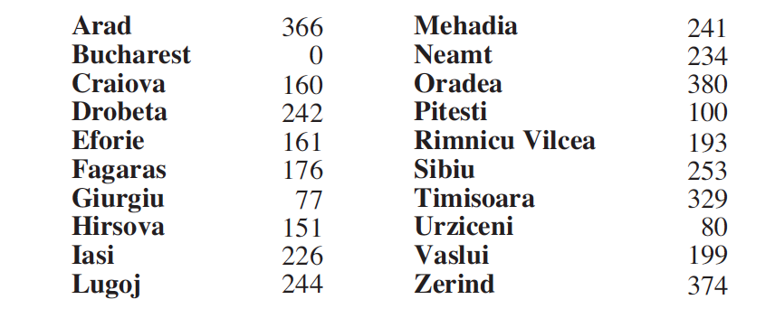
Greedy Best First Search
Expands the node that is closest to the goal
Thus, f(n) = h(n)

Slide 65
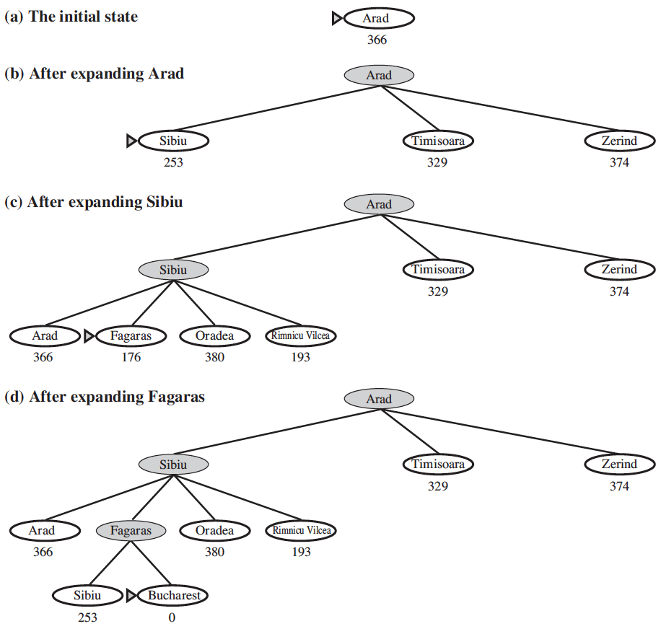
Greedy Best First
Not Optimal
Because the algorithm is greedy
It only optimizes for the current action
Not Complete
Often ends up in state with a dead end as the heuristic doesn’t guarantee a path but is only an approximation

Slide 66
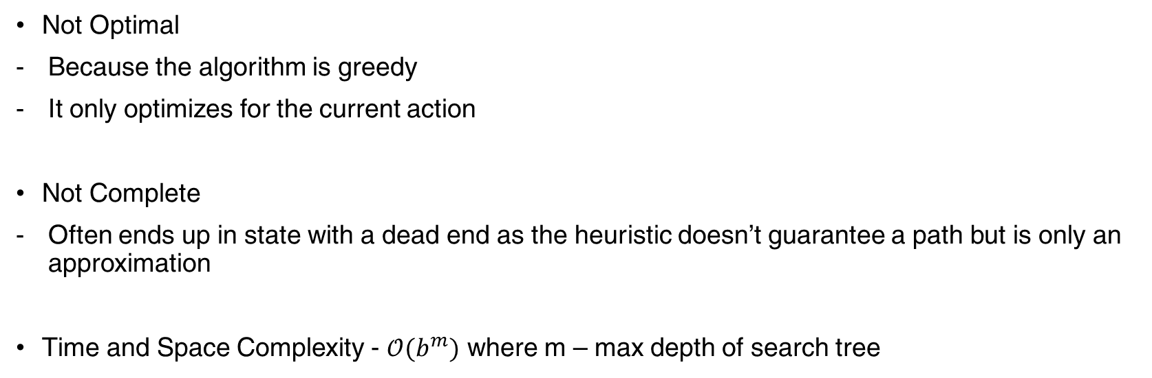
Greedy Best First Search
Not Optimal
Because the algorithm is greedy
It only optimizes for the current action
Not Complete
Often ends up in state with a dead end as the heuristic doesn’t guarantee a path but is only an approximation
Time and Space Complexity - $𝒪(b^{m})$ where m – max depth of search tree

Slide 67
A* Search
Pronounced A-star search
Most widely used
Evaluation function f(n) = g(n) + h(n)
Where g(n) – the cost to reach the node
h(n) – the expected cost to go from node to goal
Hence, f(n) – estimated cost of cheapest path through node n

Slide 68
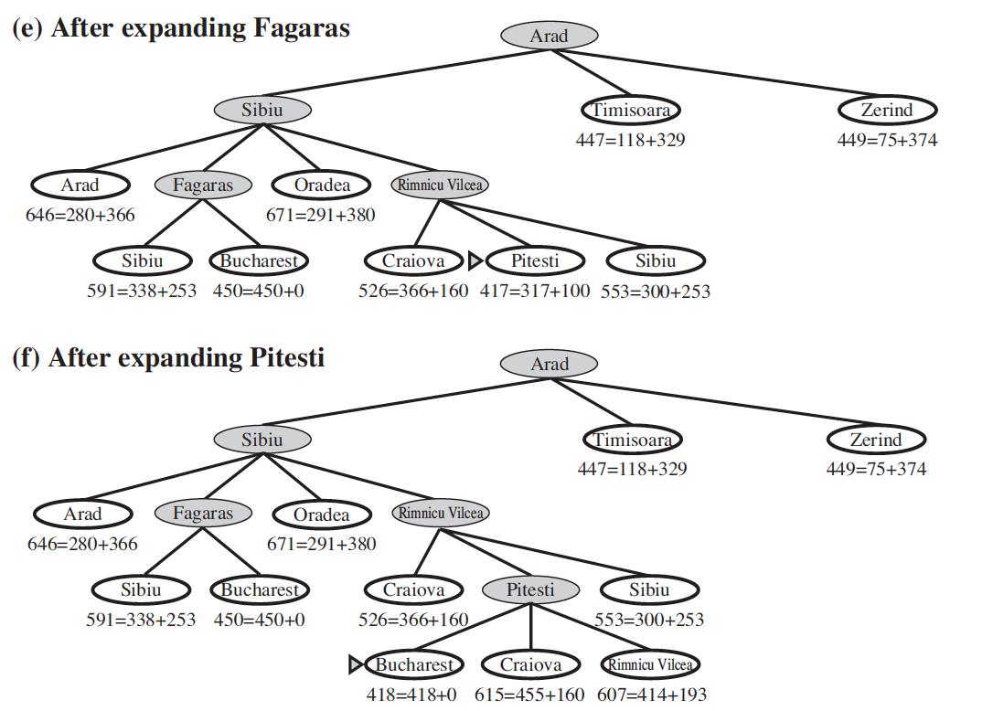
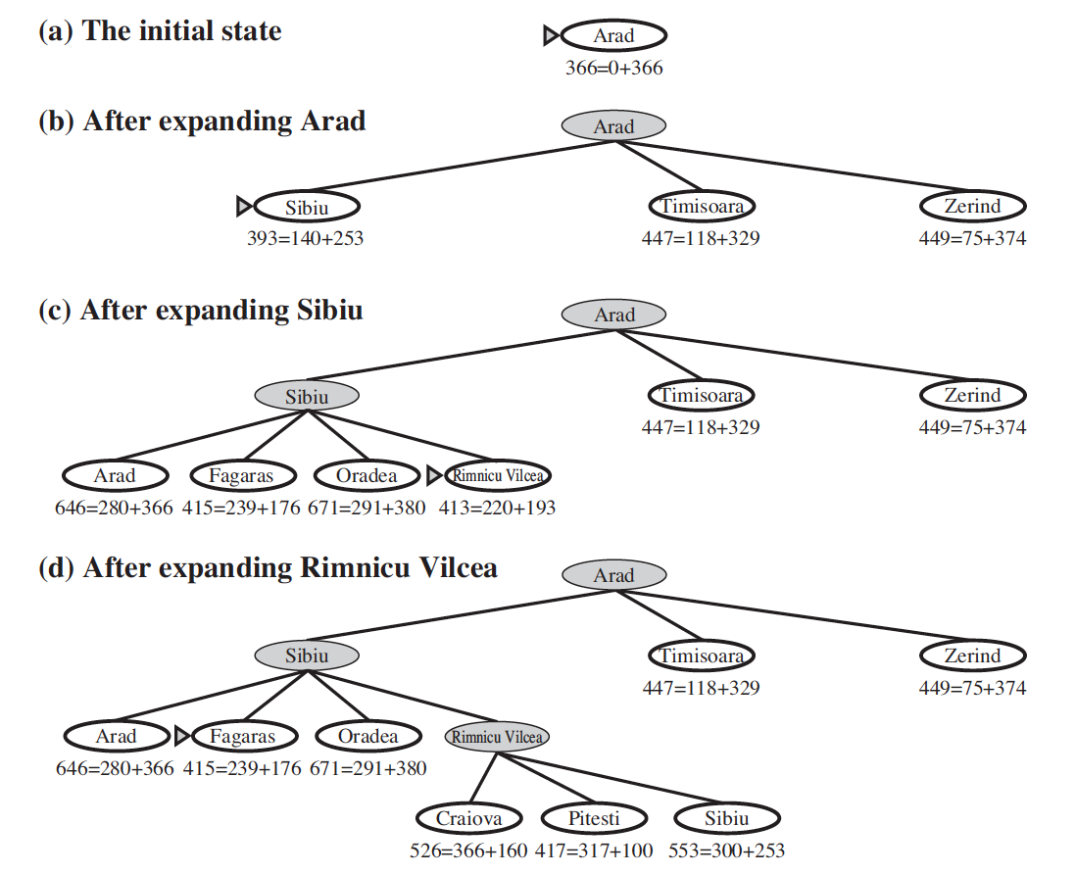
A* Search

Slide 69
A* Search
A* Search is both optimal and complete, provided h(n) satisfies two conditions
Admissible Heuristic – one that never overestimates the cost to reach the goal
E.g., straight line distance h_{SLD} it is always less than real path cost
Consistency – A heuristic is consistent if for every node n and every successor node n` of n generated by action a,
h(n) <= c(n, a, n`) + h(n`)
E.g., h_{SLD} is a consistent heuristic
h(n)
Goal state
n
g
c(n, a, n`)
h(n`)
n`

Slide 70
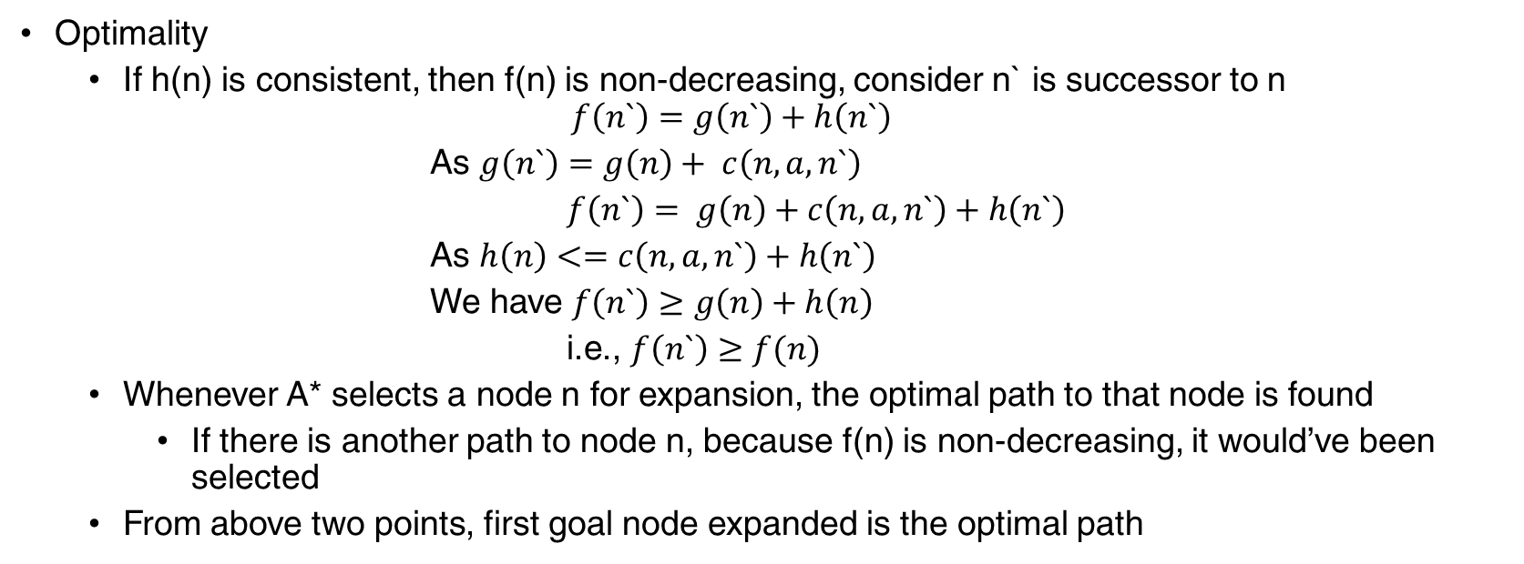
A* Search
Optimality
If h(n) is consistent, then f(n) is non-decreasing, consider n` is successor to n
$$f\left(n`\right)=g\left(n`\right)+h\left(n`\right)$$
As $g\left(n`\right)=g\left(n\right)+ c\left(n, a, n`\right)$
$f\left(n`\right)= g\left(n\right)+c\left(n, a, n`\right)+h\left(n`\right)$
As $h\left(n\right)<=c\left(n, a, n`\right)+h\left(n`\right)$
We have $f\left(n`\right)≥g\left(n\right)+h\left(n\right)$
i.e., $f\left(n`\right)≥f(n)$
Whenever A* selects a node n for expansion, the optimal path to that node is found
If there is another path to node n, because f(n) is non-decreasing, it would’ve been selected
From above two points, first goal node expanded is the optimal path

Slide 71
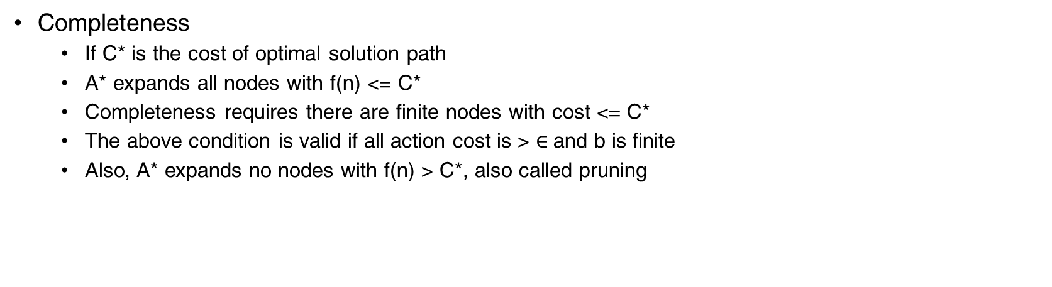
A* Search
Completeness
If C* is the cost of optimal solution path
A* expands all nodes with f(n) <= C*
Completeness requires there are finite nodes with cost <= C*
The above condition is valid if all action cost is > $∈$and b is finite
Also, A* expands no nodes with f(n) > C*, also called pruning

Slide 72
A* Search
Optimally Efficient
Among all algorithms that use the same heuristic information, A* is optimally efficient for any given consistent heuristic
No other optimal algorithm is guaranteed to expand fewer nodes than A*
Any algorithm that does not expand nodes with f(n) < C* might risk missing the optimal solution

Slide 73
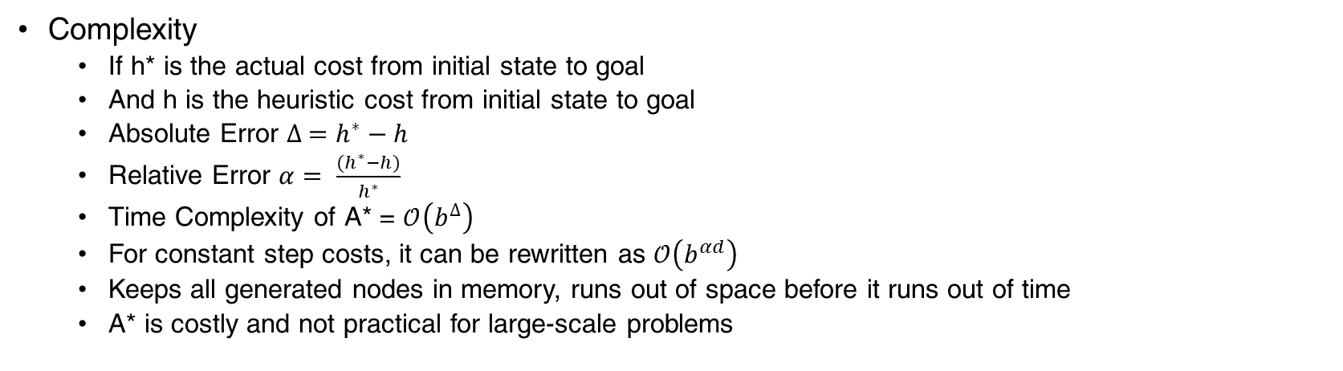
A* Search
Complexity
If h* is the actual cost from initial state to goal
And h is the heuristic cost from initial state to goal
Absolute Error $∆ =h^{∗}−h$
Relative Error $α= \frac{(h^{∗}−h)}{h^{∗}}$
Time Complexity of A* = $𝒪\left(b^{∆}\right)$
For constant step costs, it can be rewritten as $𝒪\left(b^{αd}\right)$
Keeps all generated nodes in memory, runs out of space before it runs out of time
A* is costly and not practical for large-scale problems

Slide 74
Heuristic Function
As heuristic functions determine the search strategies and thereby their complexities,
it is important that we identify better heuristic functions
While maintaining Admissible and Consistency constraints

Slide 75
Heuristic Function – Selection Criteria
Effective Branching Factor
Generating admissible heuristics from relaxed problems
Generating admissible heuristics from sub problems
Learning Heuristics from Experience

Slide 76
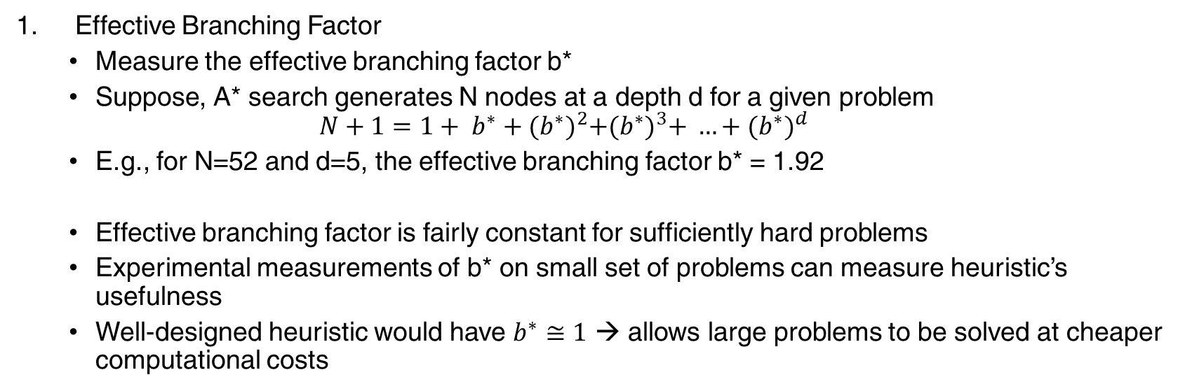
Heuristic Function – Selection Criteria
Effective Branching Factor
Measure the effective branching factor b*
Suppose, A* search generates N nodes at a depth d for a given problem
$$N+1=1+ b^{∗}+{(b^{∗})}^{2}+{(b^{∗})}^{3}+ …+{(b^{∗})}^{d}$$
E.g., for N=52 and d=5, the effective branching factor b* = 1.92
Effective branching factor is fairly constant for sufficiently hard problems
Experimental measurements of b* on small set of problems can measure heuristic’s usefulness
Well-designed heuristic would have $b^{∗}≅1$ → allows large problems to be solved at cheaper computational costs

Slide 77
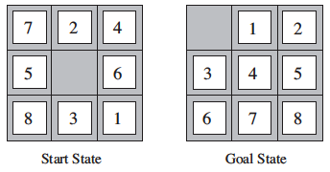
Heuristic Function – Selection Criteria
h₁ = number of misplaced tiles, admissible
h₂ = sum of Manhattan distances of tiles from their respective goal positions, admissible
Test:
Ran 1200 random simulated 8-puzzles with solution lenghts from 2 to 24
Algorithms: Iterative Deepening Search and A*
Effective Branching Factor

Slide 78
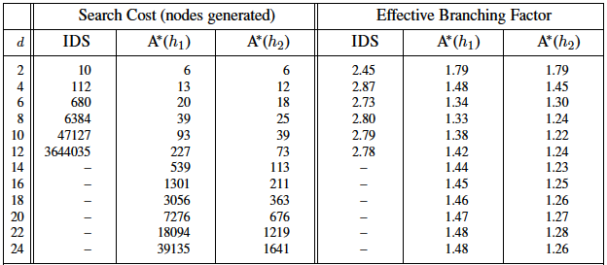
Heuristic Function – Selection Criteria
h₂ dominates h₁
A* all expands nodes with f(n) < C* and as h₂ > h₁ (h₂ is at least as big as h₁)
A* would expand fewer nodes with h₂ as it expands all nodes with h(n) < C* - g(n)
Generally, better to use heuristics with higher values

Slide 79
Heuristic Function – Selection Criteria
2. Generating admissible heuristics from relaxed problems
A problem with fewer restrictions on the actions is relaxed problem
E.g., Straight line distance in our Arad to Bucharest path finding problem
As relaxed problem adds edges
Any optimal solution in original problem is also a solution in relaxed problem
However, relaxed problem can have shortcuts and hence better solutions
Therefore, Heuristic can be the optimal solution cost in the relaxed problem
Also it is Admissible as it doesn’t overestimate the original problem

Slide 80
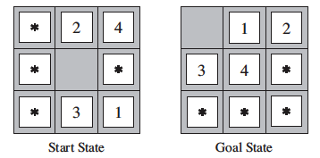
Heuristic Function – Selection Criteria
3. Generating admissible heuristics from sub problems
8-puzzle
8-puzzle sub problem

Slide 81
Heuristic Function – Selection Criteria
3. Generating admissible heuristics from sub problems
Create a Pattern Databases
Store exact solution costs for every possible subproblem instance
Every possible combination of four numbers
Construct such Databases for other combinations like 5-6-7-8, 1-2-4-5, etc
While doing search on complete state
Look up corresponding subproblem configurations in database
Add the solution costs to give Admissible Heuristic
Number of nodes generated in 15-puzzle can be reduced by a factor of 1000

Slide 82
Heuristic Function – Selection Criteria
4. Learning heuristics from experience
While solving lots of variants of the same problem, e.g., 8-puzzle
Store features that might be predictive of solution cost from a given node n
E.g., x₁(n) = “number of misplaced tiles”
E.g., x₂(n) = “number of pairs of adjacent tiles that are not adjacent in goal state”
Store these values while solving each variant
How to combine x₁(n) , x₂(n) to predict h(n)
Linear Combination: h(n) = c₁ x₁(n) + c₂ x₂(n)
Can be neural nets, decision trees
However, such h(n) is not guaranteed to be admissible or consistent

Slide 83
Thank You!
In our next session:

